Slide 1
Python2C
C with ต้องสู้

Slide 2
Input / Output

Slide 3
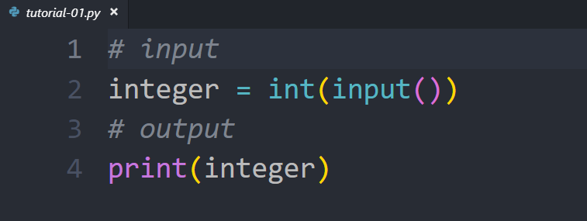

Slide 4
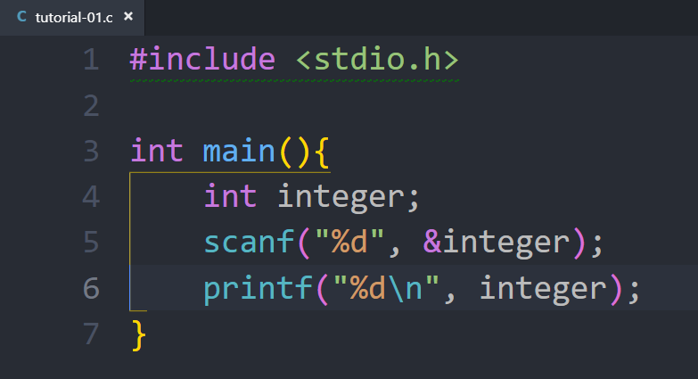

Slide 5
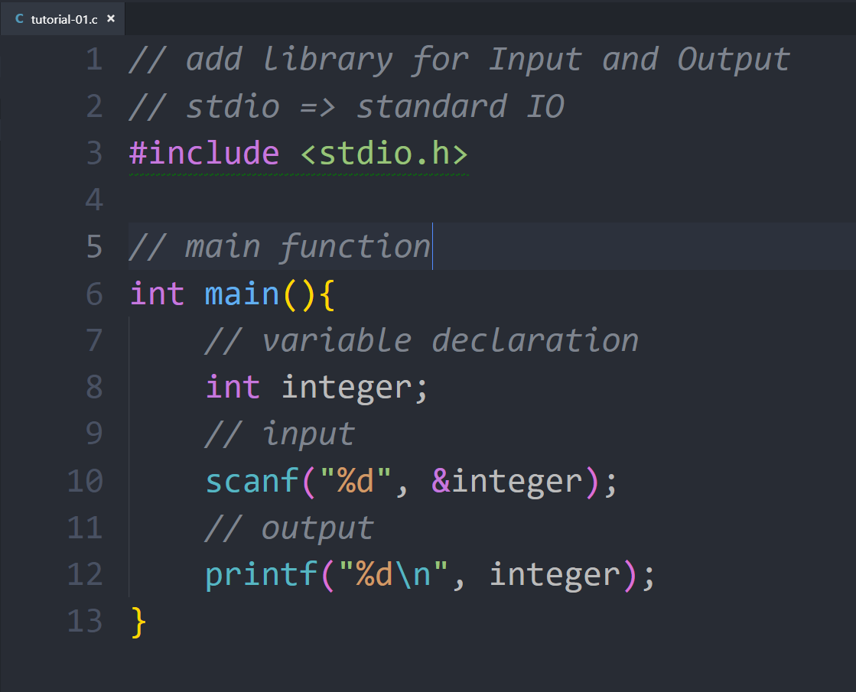

Slide 6
Try your first program

Slide 7
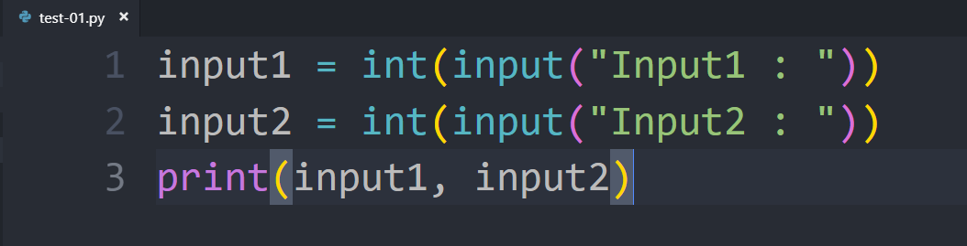
Convert this to C language

